Slide 1


Association of Computing Activities
The Huffman Highway
Mastering Compression & Navigation
Summer Project’24

Slide 2



Week-wise Project Flow
Graphs
Basic C++,STL
& Git
1
6
2
Sorting &
Recursion
7
Dynamic
Programming
3
Advanced STL
Pathfinding Algorithms
8
4
Trees
9
End-Term Eval I
5
Mid-Term Eval
10
End-Term Eval II

Slide 3


Project Flow
Week 1
BASIC C++,STL & GIT
User Input/Output
Data Types
Conditions & Loops
Functions
STL: Vectors, Pair, Array
Git & GitHub

Slide 4

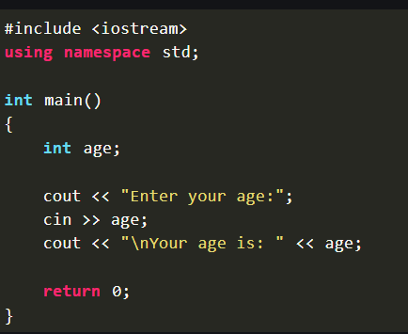
USER INPUT/OUTPUT
In real world problems, we generally take up some inputs from user and perform some functions and then provide the output.
In C++, we take inputs using cin function and to display outputs, we use cout function.
Here is an example, where we take age as an input and then print its as output.
If you want you can explore more in the following link (1)

Slide 5
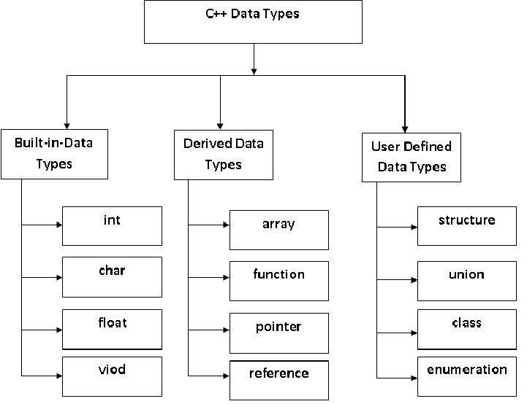
DATA TYPES
It defines what type of data will be stored in the variable defined.
Different types of data types are:
1) Integer
2) Float
3) Double
4) Character
5) String
6) Boolean, etc.
You can explore more on (2)

Slide 6
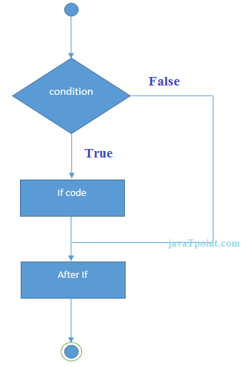
CONDITIONS
We use conditional statements only when we want to execute a part of code, if a condition is satisfied.
In C++, there 2 ways to write conditional statements:
1) Switch-Case Statements (3)
2) If-else Statements (4)
We can write if statements in if or switch and vice versa. This is called Nesting. (5) (6) (7)
Well there are difference in switch-case and if-else statements and it depends on user and conditions to decide which one to prefer. (8) (9)

Slide 7
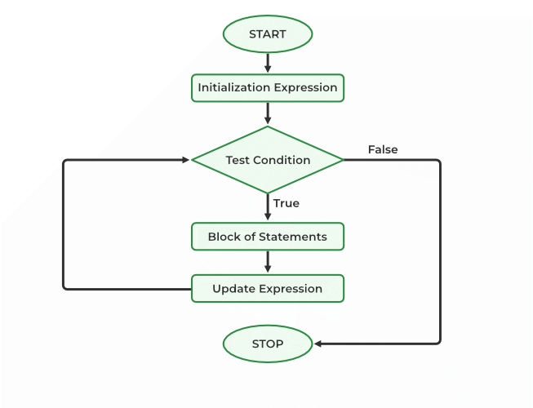
LOOPS
Loops are very useful functions. They helps to iterate a set of code any finite number of times.
For making loops, we can use any of the following 3 functions:
1) For loop (11)
2) While loop (12)
3) Do While loop (13)
We can use any of the loop function to write our code.
Genarally, most of the people prefers using for loops.
Also, loops and conditional statements can be nested into each other.

Slide 8

FUNCTIONS
A function is a set of statements defined by user which takes up some input, and then processes all the codes written in the function and returns the output.
Functions are used when a set of statement are being used repeatedly or to make our code look more readable.
Functions are of 2 types:
1) Library Function (e.g. sqrt)
2) User-defined Function
Input
In user defined functions, we have 2 ways to pass a parameter (input):
1) Pass by value
2) Pass by reference.
Operations
Coder :)
You can check out more on functions in the given article (14)
Output

Slide 9
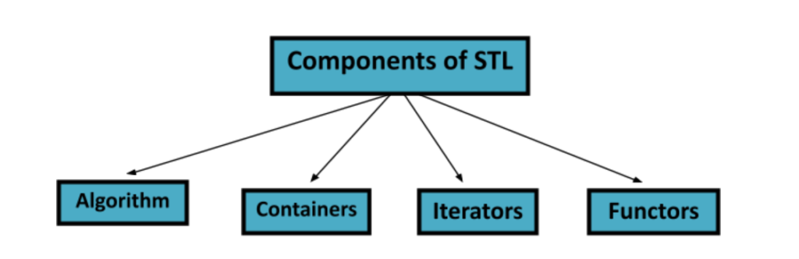
STL (STANDARD TEMPLATE LIBRARY)
STL is a set of generic classes and functions.
Quick Read (16) (17)
It would be helpful for you to understand STL, if you know about Templates.

Slide 10
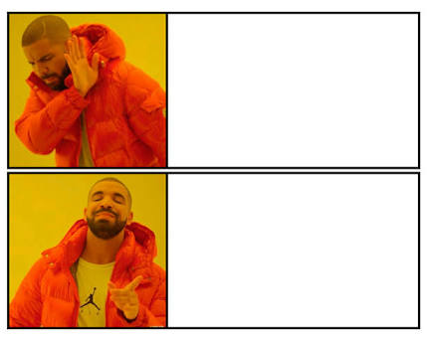

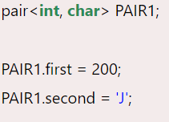
PAIRS
Pairs are containers that allow us to store two values as a single element. The values may or may not be of the same data type.
Pairs store values as {first, second}, the order of values is fixed. The values can be accessed using the dot operator followed by keywords.
Syntax to write up Pairs:
pair <data_type1, data_type2> Pair_name;
You can check out more on Pairs from following article (18)

Slide 11
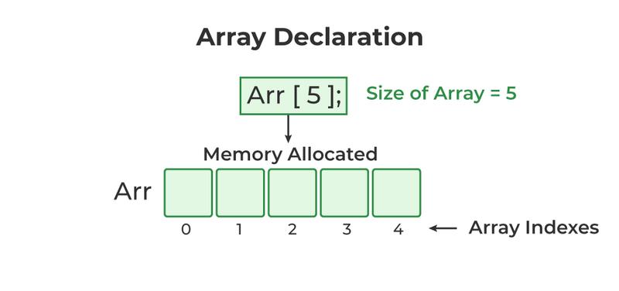
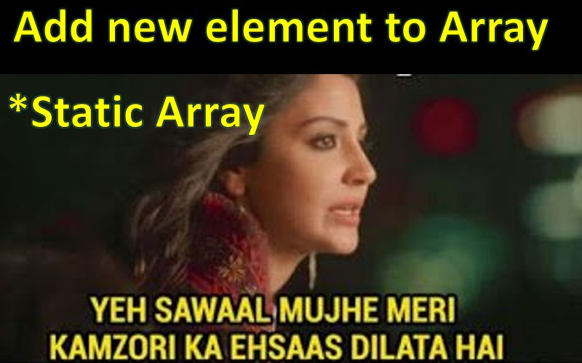
ARRAYS
An array can be defined as a group or collection of similar kinds of elements or data items that are stored together in contiguous memory spaces.
All the memory locations are adjacent to each other, and the number of elements in an array is the size of the array.
To declare an array, define the variable type, specify the name of the array followed by square brackets and specify the number of elements it should store
The number of elements in an array is fixed and can’t be altered again.
Take a read on arrays (19)

Slide 12

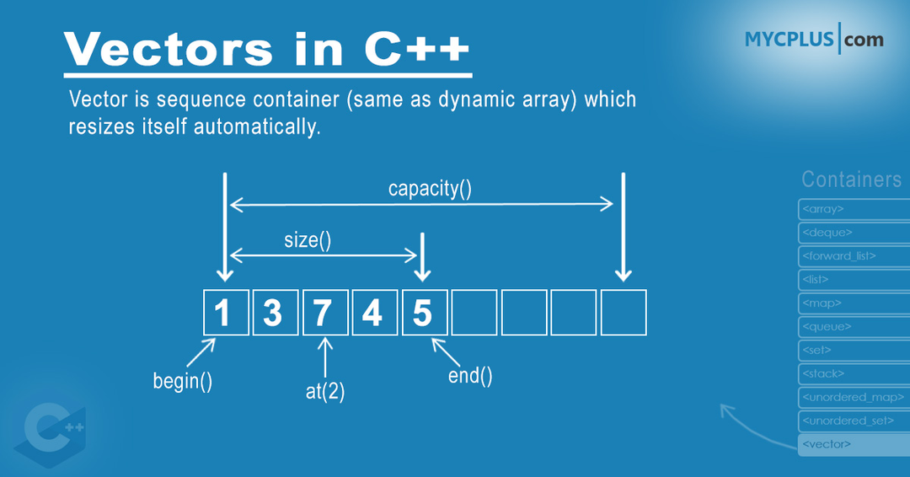
VECTORS
Vectors are run-time sequence containers that represent arrays with variable size.
Their elements may also be accessed utilizing offsets on conventional pointers to their elements since they employ contiguous storage spaces for their elements just as effectively as in arrays
Vectors
Arrays
Explore more about vectors on (20)

Slide 13
GIT & GITHUB
Git is a popular version control system. It is used for:
Tracking code changes
Tracking who made changes
Coding collaboration
Git is not the same as GitHub. GitHub makes tools that use Git.
GitHub is the largest host of source code in the world, and has been owned by Microsoft since 2018.
You can learn about Git from the following video
If you want you can learn more about Git and Github here(21)
Note: For this project, we will collect all your assignments through Github only. You will share the link of your Github repository in which you have uploaded your assignments solution

Slide 14



Contacts...
Shivam Sharma:
+919569314977
Gautam Chandak:
+919755180883
Harsh Shah:
+917457950387
Siddhant Lalpuria:
+919057781000

Slide 15
THANK YOU!!!

